Slide 1

Positive and Negative Congruency Effects in Masked and Unmasked Priming:
Match of representation strength, Attention, and Consciousness
Ahmad Sohrabi
Institute of Cognitive Science
Carleton University
2007
Notes:
I am going to present a summary of my thesis. Here is the title …

Slide 2






Introduction
In priming, a masked/unmasked stimulus (prime) can affect the processing of the following stimulus (target).
3 dhnpg 2
8 wfjnh 2
congruent
Incongruent
task
<5 >5
Prime Mask Target
  Two opposite effects in priming:
    Positive Congruency Effect (PCE); RTs in congruent trials are faster than incongruent.
    Negative Congruency Effect (NCE); RTs in incongruent trials are faster than congruent!
Notes:
In my study I have used priming and masking techniques. So, I am briefly saying what the priming and masking are. In priming a masked or unmasked stimulus (called prime) can affect the processing of the following stimulus (called target). For example, the task could be to press a right key when the target is a happy face and to press the left key when the target is a sad face. The prime, mask, and target are presented in order. Here is an example of a congruent trial. The prime is presented, followed by a mask, and the mask is followed by the target. The stimuli are presented at the same location and because the prime is presented briefly and followed by the mask, the prime is not visible but it still can facilitate the decision on the target. The trial could also be incongruent. Here the prime is a sad face but the target is a happy face. Two opposite effects in priming:
Positive Congruency Effect (PCE); congruent trials are faster than incongruent.
Negative Congruency Effect (NCE); incongruent trials are faster than congruent!

Slide 3
Thesis Goals
Push the envelope for masked priming with new stimuli
Develop a neural cognitive model that can account for the wide variety of effects in this area

Slide 4
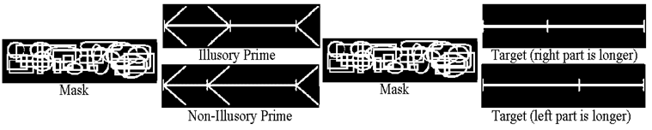
Experiment 1
Can illusions act as primes?
71 ms 43 ms 71 ms 200 ms
Examples of stimuli in Experiment 1 (perceptual representation)
The task was to select the longer part with a left or right key.
Notes:
The current study was aimed to elucidate the main factors that change the priming effects. This is the design of the tasks used in the current study. In the masked condition, the prime is sandwiched between two masks. In the unmasked condition, the prime is presented and after a blank interval the target is presented. Here are some examples of stimuli used in Experiment 1. This experiment tested the factors involved in priming in a perceptual representation domain. The mask was random shapes, as both forward and backward masks. The prime was either illusory (MÜLLER-LYER) or non-illusory (lines with different parts and arrows pointed left or right randomly). And the targets had no arrows. The task was to select the longer part with a left or right key.

Slide 5
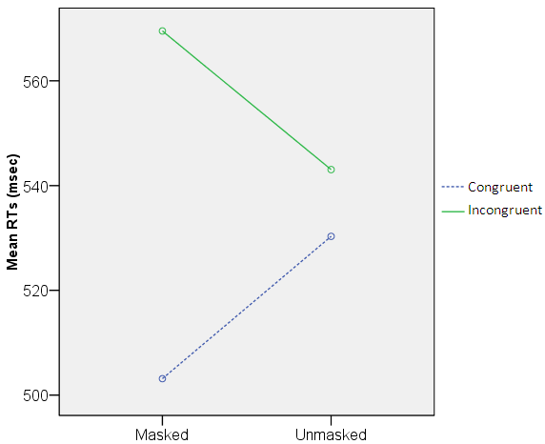
Experiment 1: Behavioural results
Masking and Congruency effects:
both Illusory and Non-Illusory
PCE
Notes:
Here is the result. In both masked and unmasked conditions participants were faster in congruent than incongruent trials (showing PCE). A significant PCE was only found in the masked condition.

Slide 6
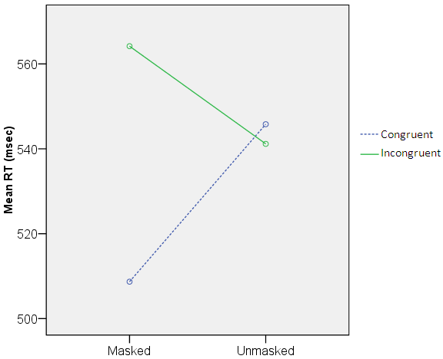
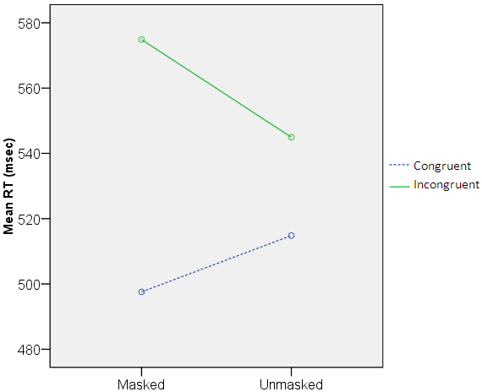
Experiment 1: behavioural results contd.
Masking and Congruency effects:
Non-Illusory Illusory
PCE
PCE
Notes:
Here is the same result for the non-illusory and illusory conditions separately. PCE in masked and no significant priming in the unmasked.

Slide 7
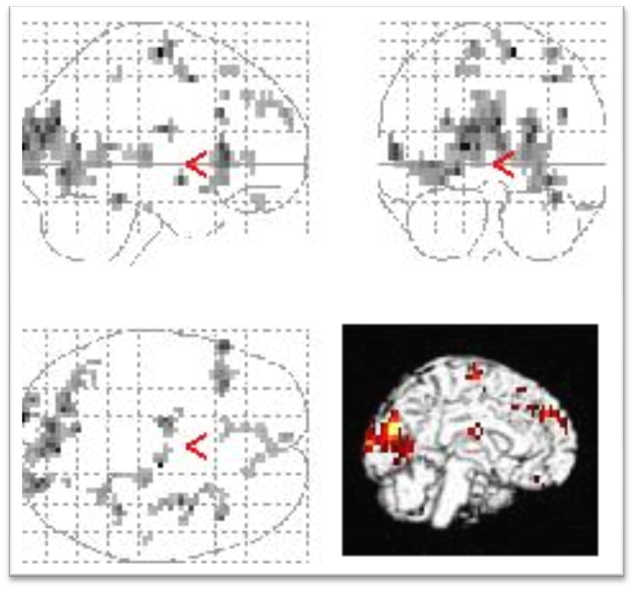
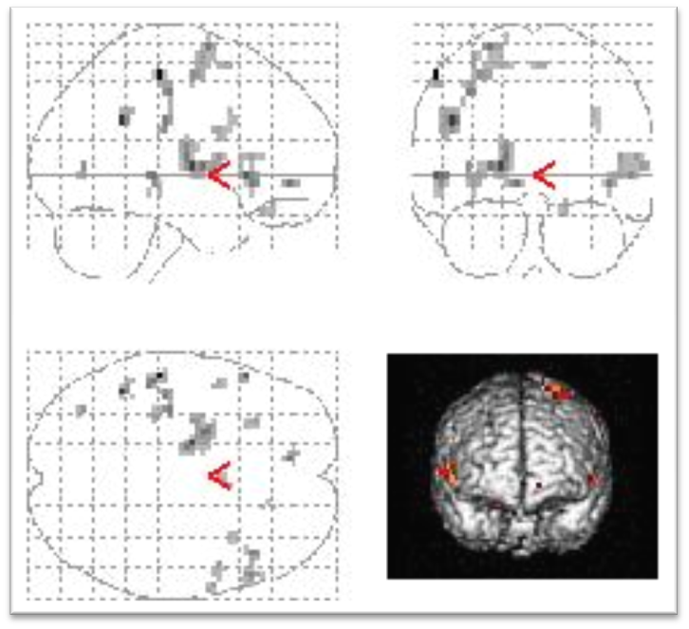
Experiment 1: fMRI results
Activation results :
Unmasked – Masked Illusory – Non-Illusory
Notes:
This is the fMRI result. Unmasked – masked: As you see, in the unmasked condition compared to masked brain activation was higher. Illusory – non-illusory: The brain activation was higher for the illusory than non-illusory. Opposite contrasts were not significant. Previously a widely spread activation has been shown in reportable stimuli compared to unreportable.

Slide 8
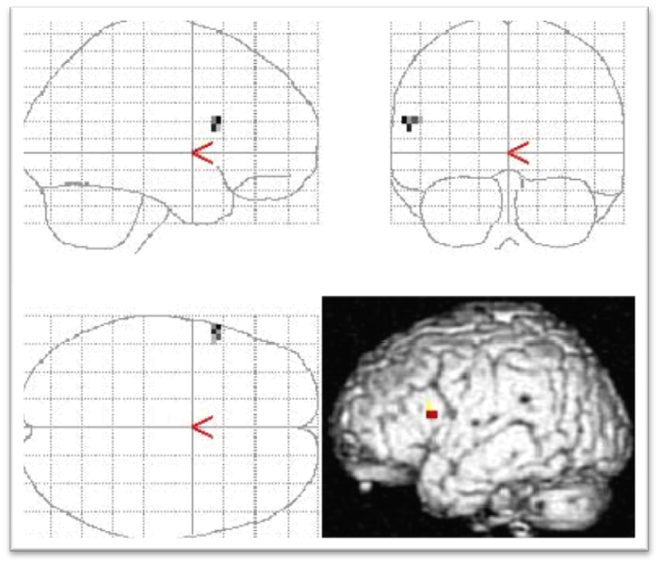
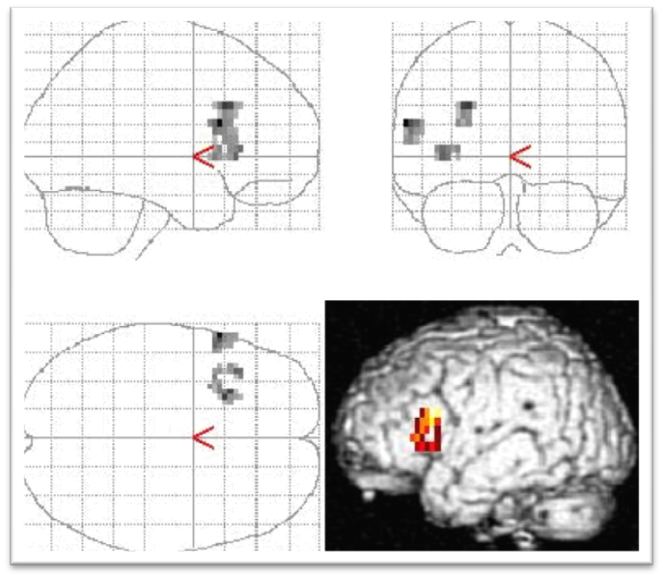
Experiment 1: fMRI results contd.
Activation results (left IFG and dl-PFC):
Unmasked Illusory – Masked Illusory Unmasked Illusory – Unmasked Non-Illusory
Notes:
More specifically, unmasked illusory correlated with higher activation in IFG and dl-PFC compared to other conditions, masked illusory and unmasked non-illusory. This area is supposed to involve in control and inhibition.

Slide 9
Main fMRI results
left IFG and dl-PFC are activated for unmasked, illusory condition
  This perhaps means that participants invoke some control functions when they saw the illusory prime, i.e., when the prime was unmasked (visible/reportable).
What this shows is that illusions can create neural signatures that are not related to the illusion occurring, but to a conscious reaction to the illusion
The masked illusion does not seem to activate these areas
This could provide a new paradigm for studying neural activation related to illusion

Slide 10
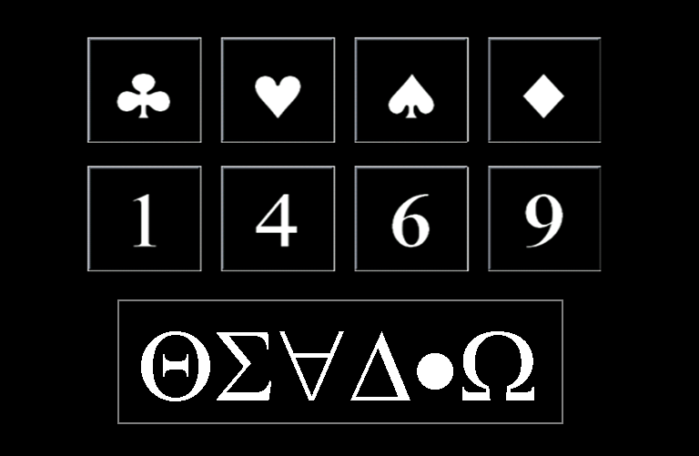
Experiment 2 (symbolic representation)
Can recently learned symbols produce priming effects?
Training and priming phases
The priming task was to press the left key for numbers <5 and the right key for numbers >5.
Two conditions in the priming task:
  Symbol-Number
  Number-Symbol
Prime or Target
Mask
Stimuli in Experiments 2-4
Notes:
Experiment 2. This experiment and following ones tested the factors involved in priming in a symbolic representation domain; well-learned vs. recently learned symbols. These are the stimuli: playing card symbols and Arabic numeral symbols as the prime or target and irrelevant symbols as the mask. There was a training phase and a priming phase. In the training phase, participants memorized these symbols as numbers. They were trained, and tested, to associate each symbol to a number and to treat the symbols as numbers in the priming phase. There were two types of trials. In Symbol-Number, a symbol primed a numeral and conversely in Number-Symbol, a numeral primed a symbol. The task was to press the left key for numbers less than 5 and the right key for numbers greater than 5 (including the symbols).

Slide 11
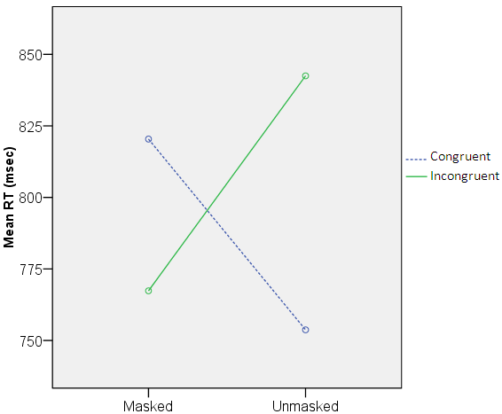
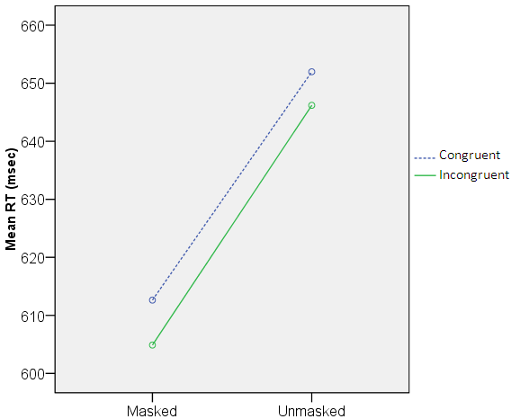
Experiment 2: results
Masking and Congruency effects
Number-Symbol Symbol-Number
NCE
Notes:
This is the result. In the number-symbol condition, there was an NCE and in the masked and a non-significant PCE in the unmasked condition. In the symbol-number condition, ther was no significant priming effects but the pattern was a small NCE.

Slide 12
Experiments 3 and 4
Experiment 3 and 4 were done to further investigate the effect found in Experiment 2
  Effect of predictability
  Effect of numerical distance
Notes:
Experiment 3. Experiment 2 both masked and unmasked trials were mixed together. The distance factor (close or far from five) was not controlled. Also A symbol target was always followed by a numeral target and vice versa (so the target could be predicted by the prime). To control these effects Experiment 3 and 4 were conducted. This experiment was identical to previous one. But a fixation cue was presented at the beginning of each trial (# or * randomly). All trials were masked here. There were two conditions here: Number-Number where a numeral primed a numeral. And Number-Symbol, where a numeral primed a symbol. Here, Distance factor was controlled to see its effects on priming.

Slide 13
Experiment 3
A fixation point (# or * randomly) came before other stimuli.
Two conditions (both masked):
  Number-Number
  Number-Symbol (as in Experiment 2)
Distance factor (close or far from five) was controlled.
Notes:
Experiment 3. Experiment 2 both masked and unmasked trials were mixed together. The distance factor (close or far from five) was not controlled. Also A symbol target was always followed by a numeral target and vice versa (so the target could be predicted by the prime). To control these effects Experiment 3 and 4 were conducted. This experiment was identical to previous one. But a fixation cue was presented at the beginning of each trial (# or * randomly). All trials were masked here. There were two conditions here: Number-Number where a numeral primed a numeral. And Number-Symbol, where a numeral primed a symbol. Here, Distance factor was controlled to see its effects on priming.

Slide 14
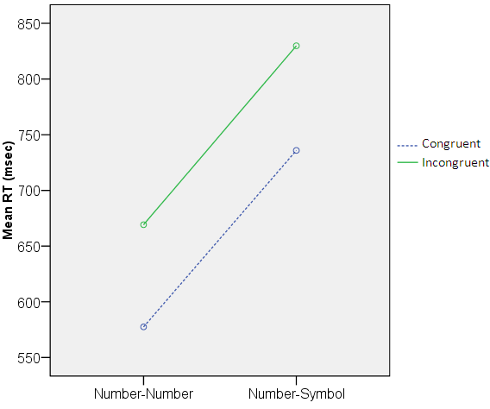
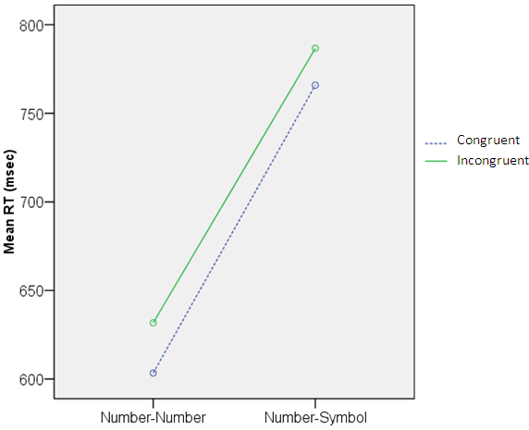
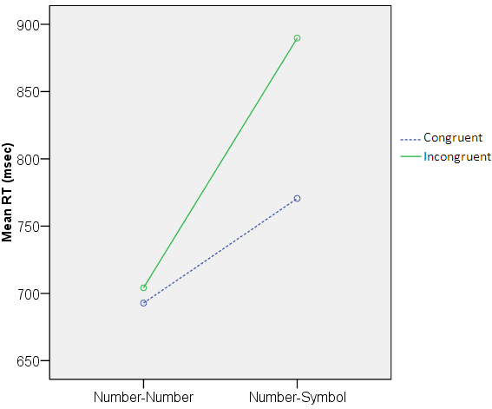
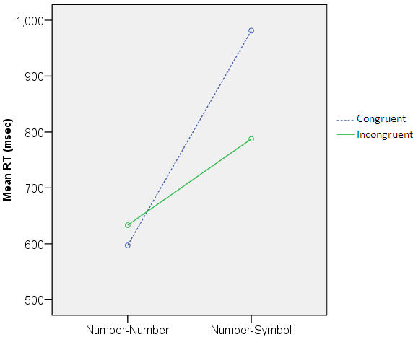
Experiment 3 results: Distance and Type
Far-Far Close-Far
Far-Close Close-Close
PCE
NCE
Notes:
Here is the result for Number-Number and Number-Symbol conditions and different distances separately. As you see, there was a significant PCE in Number-Number at Far prime-Far target trials and at the other extreme, a significant NCE in Number-Symbol at Close prime-Close target trials. So, in general when the prime and target were easy or had stronger representation they were processed faster than when the prime and target were hard or had weaker representation.

Slide 15
Experiment 4
Done immediately after Experiment 3 with the same subjects.
The fixation cues revealed the target’s identity, because # always came with Number-Number and * came with Number-Symbol.
ANOVA showed no significant priming effect. So cueing made the priming disappear.
Notes:
Finally, Experiment 4. As I said before, in Experiment 2 the target could be predicted by the prime. To control this effect, while in Experiment 3, fixation cues were presented randomly, here the fixation cues revealed the target’s identity, because # always came with Number-Number and * came with Number-Symbol. ANOVA showed no significant priming effect. So cueing made the priming disappear showing that predictability was not the cause of NCE in Experiment 2.

Slide 16
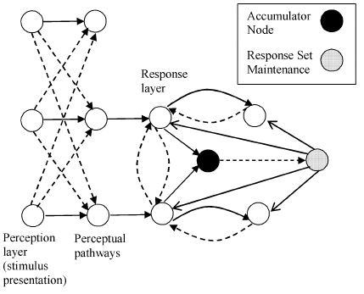
Previous Models
Bowman, Schleghecken, & Eimer (2006) is the only model that produces both PCE and NCE
Weaknesses
  AI inspired neural network model
  Not neurally or cognitively plausible
  Does not reproduce some core findings

Slide 17
Modeling Goals
Able to model a wide variety of effects with minimal and realistic parameter changes
Create a model that is neurally plausible
  Based on established neural mechanisms and algorithms
Create a model that integrates basic cognitive mechanisms in a plausible way
  It consists of different layers that are shown in the following slides: Input layer (IL), representation layer (RL), alert attention layer (AA), cognitive layer (CL) and motor layer (ML).

Slide 18
Different types of connections
  Excitatory connection 
  Excitatory crosstalk -
  Self excitation ☹
  Inhibitory connection •-•
  Modulatory connection −♦

Slide 19
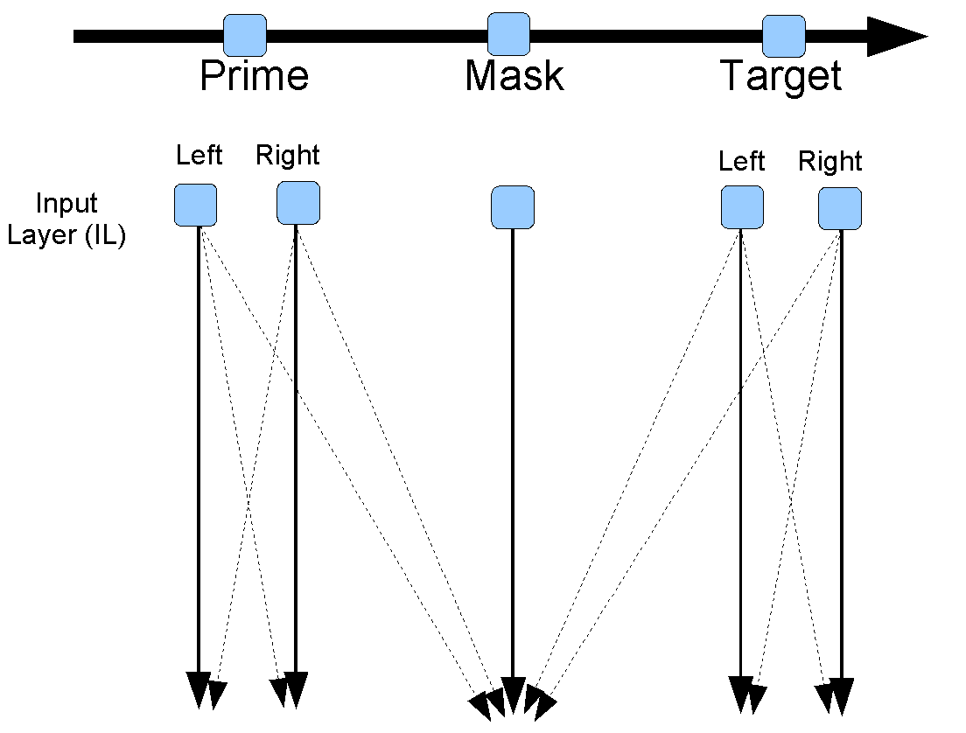


Slide 20
Weights determined by the relevance of the input for the
task

Slide 21
Weights determined by the relevance of the input for the
task
Projects to representation layer

Slide 22
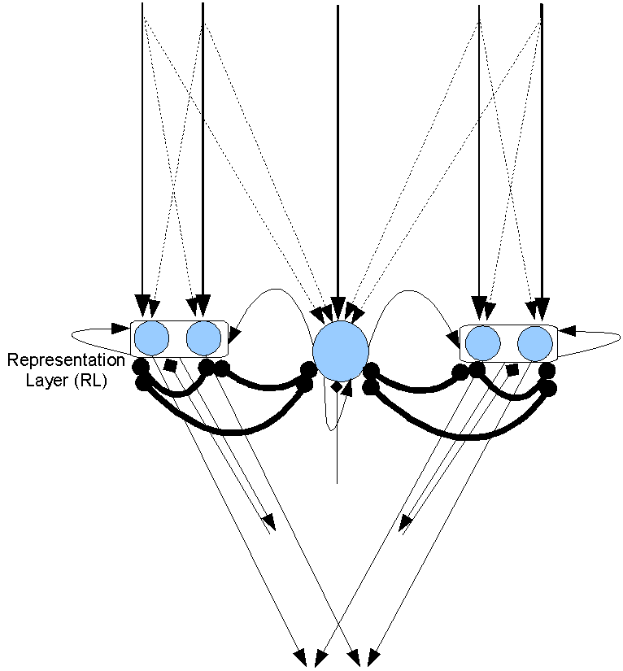
Prime
Mask
Target

Slide 23
Connections go to the attention system

Slide 24
Connections go to the attention system
And to the motor and cognitive systems (not show here)

Slide 25
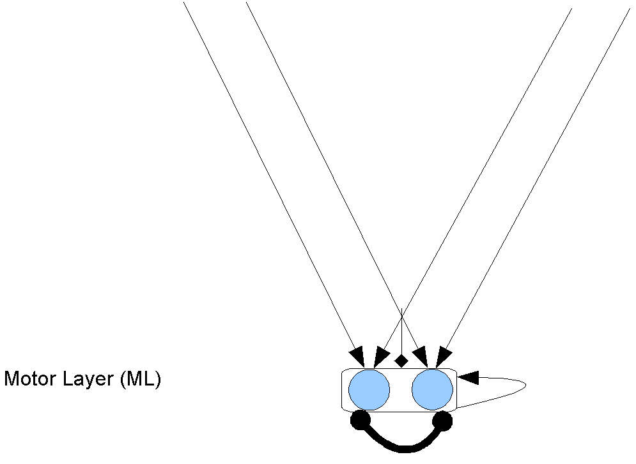
The motor layer does not feed back into the model. It just fires when it exceeds a threshold.

Slide 26
The motor layer does not feed back into the model. It just fires when it exceeds a threshold.
To simplify the presentation the motor layer will not be included in future diagrams of the model

Slide 27
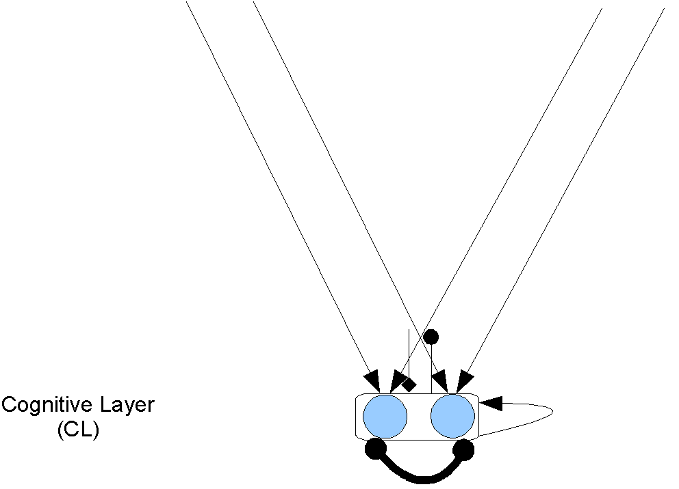
The cognitive layer is similar to the motor layer

Slide 28
The cognitive layer is similar to the motor layer
Conflict causes inhibition, which changes the attentional mode from phasic to tonic

Slide 29
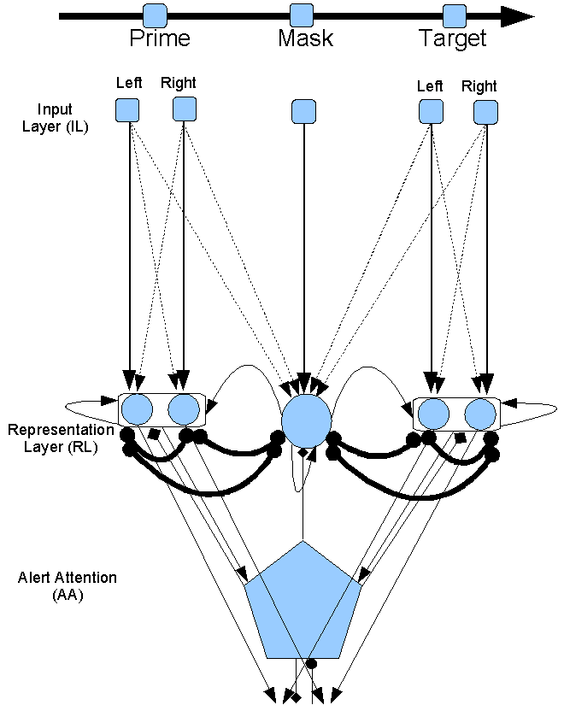
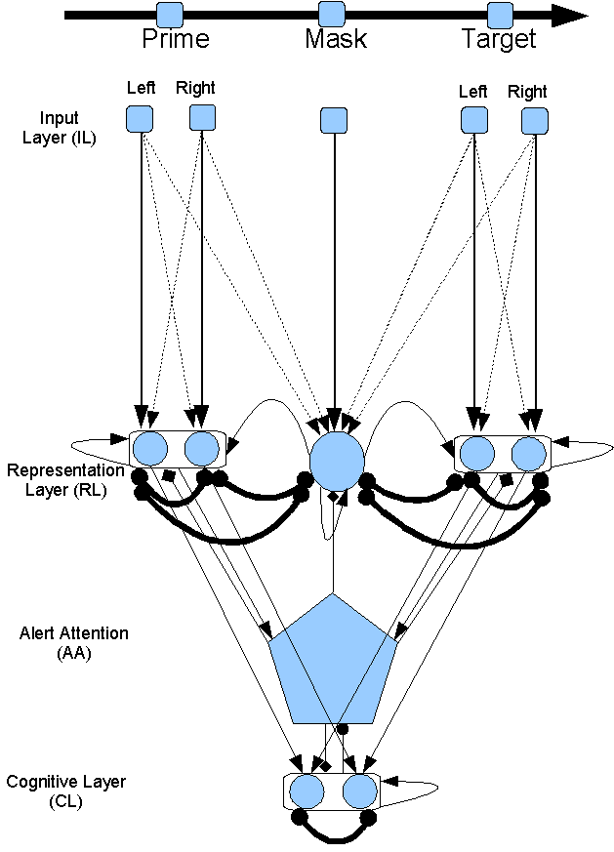
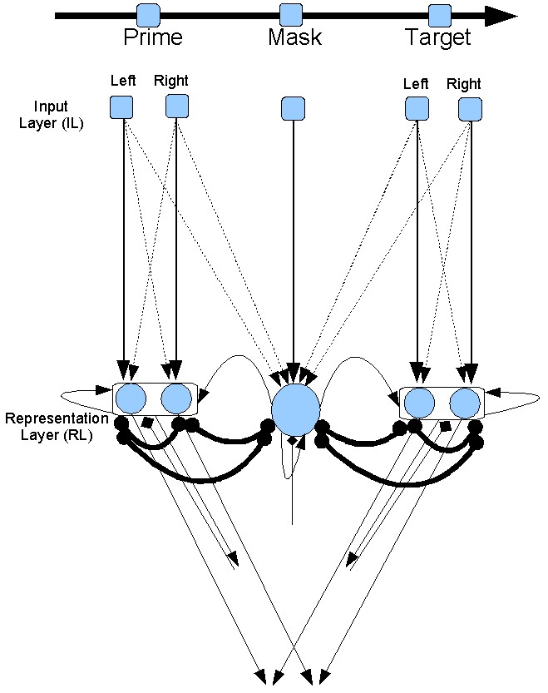
All layers together

Slide 30
Fitting the model
As noted, only the weights of IL-RL were adjusted in main conditions
No scaling was done, only the raw modeling results are shown
At this point the goal was to achieve qualitative fits across a range of results

Slide 31
Simulations of other studies

Slide 32
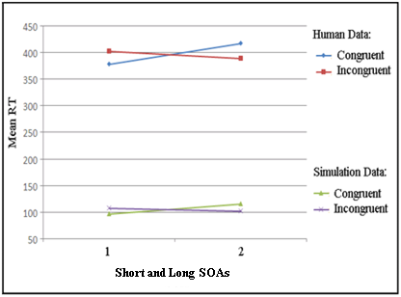
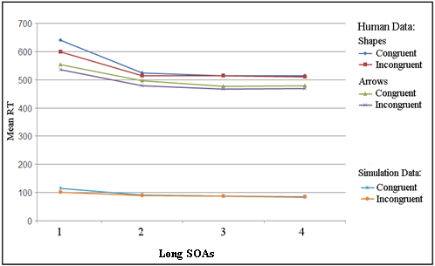
Simulation of PCE at short and NCE at long mask-target SOA
Shorter SOAs
Longer SOAs
Left: (Schleghecken & Eimer, 2000).
Right: (Jaśkowski & Ślósarek, 2006).
Notes:
This is the same result to compare with human data. The simulation is similar to human data.

Slide 33
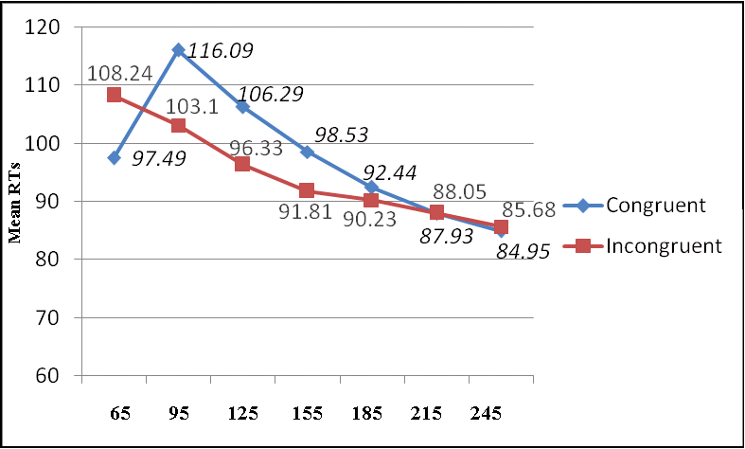
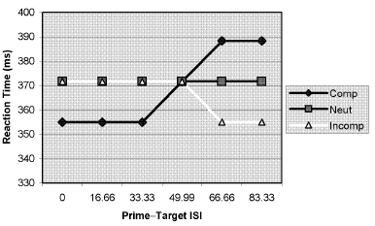
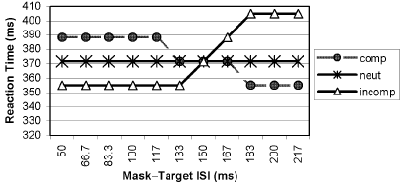
Current Model
Shorter
SOAs
Longer
Bowman et al.’s model
NCE
PCE
PCE
NCE
Notes:
There are some other factors that affects priming direction shown in previous studies. The main one is mask-target SOA or stimuli onset asynchrony or prime-mask SOA. A PCE has been shown with short SOA and an NCE with longer SOAs. The model simulated this effect. There is a model of this effect shown here. As you see it does not show a gradual decrease in RT and a slow decrease in NCE by time.

Slide 34
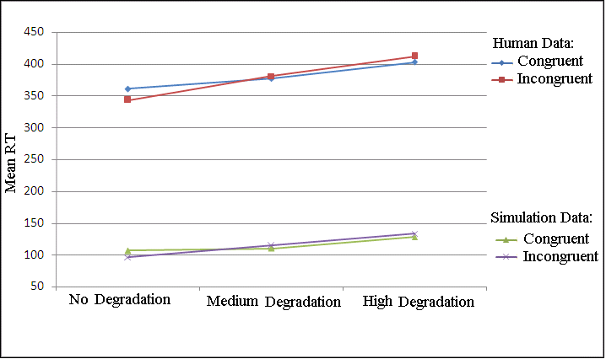
Simulation of stimuli degradation
Degradation result compared to human data (Schleghecken & Eimer, 2002, Exp. 4).
No degradation: 1 (vs. 0), Medium degradation: .85 (vs. .15), High degradation: .75 (vs. .25), and a small increase in noise in RL.
Notes:
Stimuli degradation (adding random dots to the background of the stimuli) turns NCE to PCE as happens in the simulation.

Slide 35
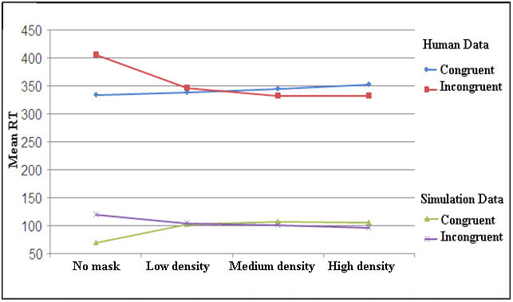
Simulation of mask density
Four levels of mask density (Eimer & Schleghecken, 2002, Exp. 1).
No mask, low density, medium density, and high density, simulated by mask unit’s activations 0, .45, .55, and 1 compared to ≥ 15, 10, 5, 0 random line masks in human data, respectively
Notes:
Decreasing mask density turns NCE to PCE as happens in the simulation (right to left).

Slide 36
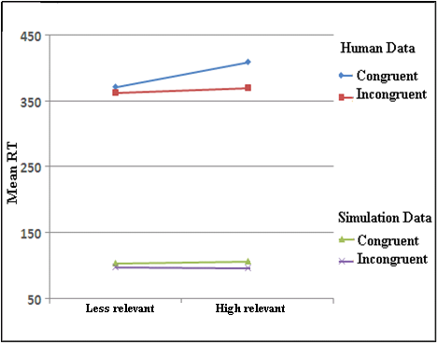
Simulation of mask relation
Mask relation compared to human data (Lleras & Enns, 2005).
By changing excitation from mask to Prime and target: low excitation (.65 ) and high excitation (.75) for less and high relevant mask, respectively.
Notes:
Larger NCE in the relevant masks.

Slide 37
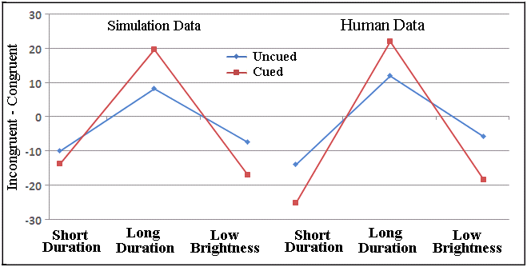
Simulation of spatial cueing
RT difference (Incongruent - Congruent) in the spatial attention to the prime compared to human data ( Summer et al., 2006).
Notes:
Cueing the prime location increases NCE and PCE as you see. This is the RT differences in Incongruent – congruent.

Slide 38
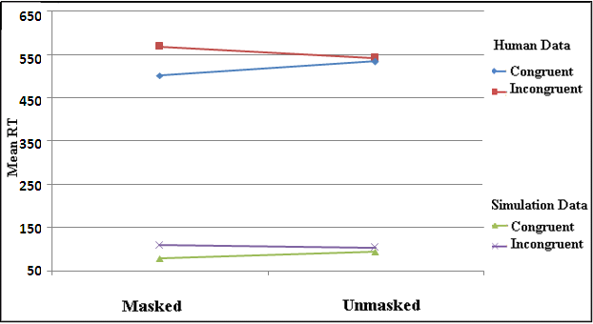
Simulation of masking effect in Experiment 1
Prime-target strength 3-3 (IL to RL weights),
with less phasic attention to the prime in the unmasked
Notes:
Simulation 1 simulated Experiment 1. As you see the PCE in the masked decreased in the unmasked similar to human data. Here are more details on this, if needed I will get back to this later.

Slide 39
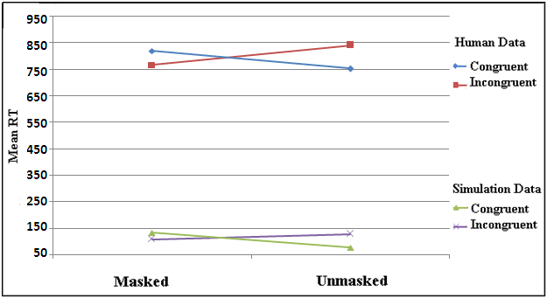
Simulation of masking effect in Experiment 2 (Number-Symbol)
Prime-target strength 2.75-2.25 (IL to RL weights),
with medium phasic attention to the prime.
Notes:
Simulation 2 simulated Experiment 2. As you see the NCE in the masked turned into PCE in the unmasked similar to human data. Here are more details on this, if needed I will get back to this later.

Slide 40
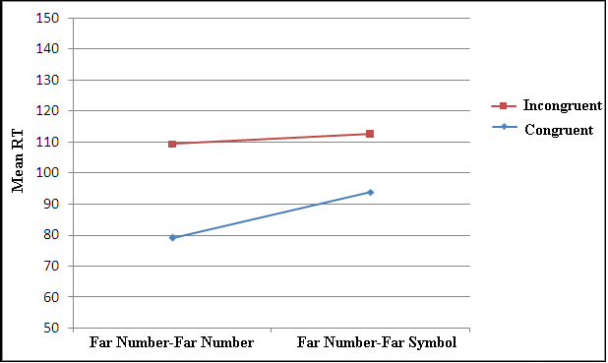
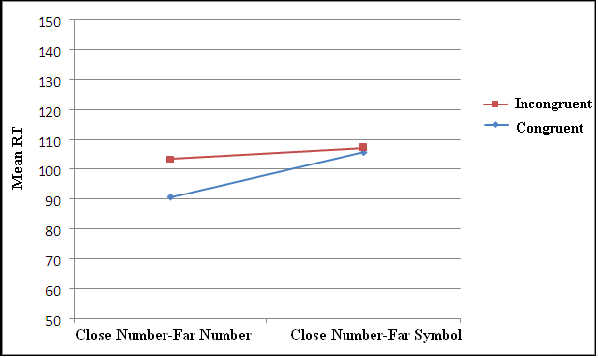
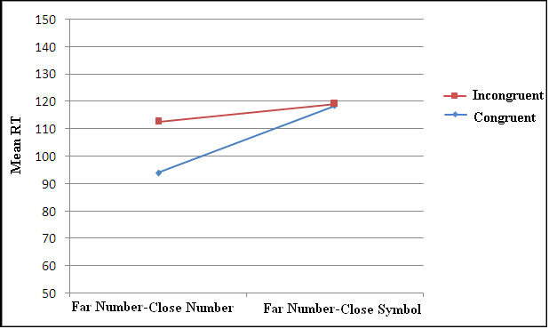
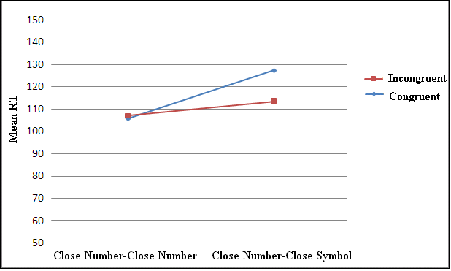
Simulation of type and distance effects in Experiment 3 cntd.
Far-Far Close-Far Far-Far Close-Far
Far-Close Close-Close Far-Close Close-Close
Human data Simulation results
Notes:
Simulation 3 simulated Experiment 3. As you see, the PCE and NCE was found in the simulation results similar to human data. If needed I will get back to this later for more details.

Slide 41
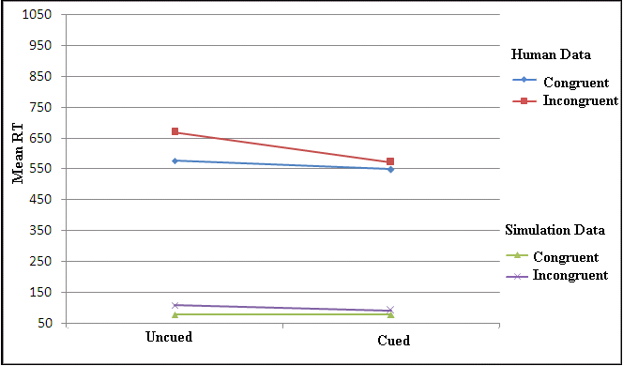
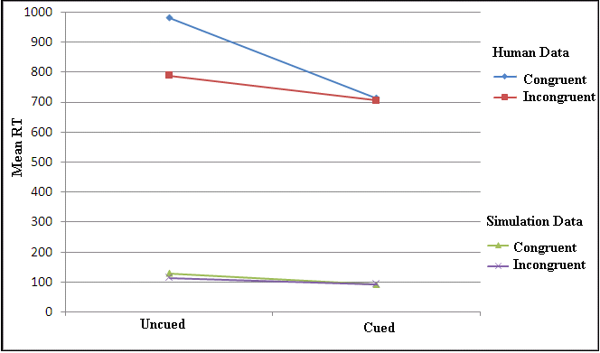
Simulation of Experiment 4 (cued) compared to Experiment 3 (uncued)
Far Number Prime and Far Number Target Close Number Prime and Close Symbol Target
Cue created an attentional refractory period (in AA) for the prime, making it weaker, but made the target stronger (modulated by OA), so it caused NCE and PCE disappear.
Notes:
Simulation 4 simulated Experiment 4. As you see the PCE and NCE disappeared by the cue similar to human data. More details on this if needed I will get back to this later.

Slide 42
Questions?

Slide 43
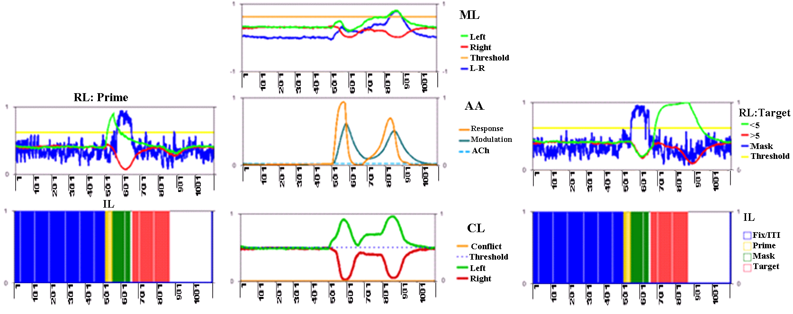
Activations in the model (a congruent trial, SOA 125)

Slide 44
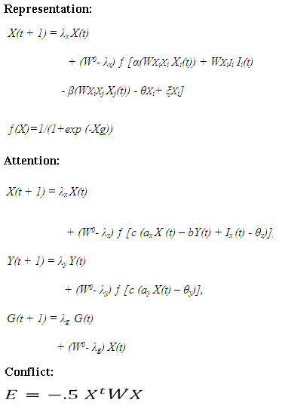
Some equations

Slide 45
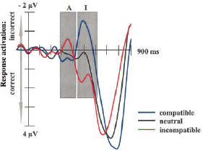
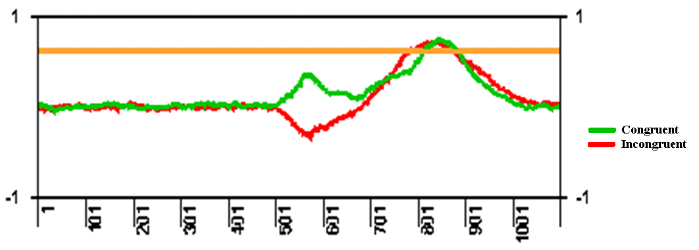
Left-Right in ML (congruent and incongruent trials)
Left: Domination of activation in the congruent and incongruent trials at short and long SOAs, respectively.
Right: ERP data (Eimer & Schleghecken, 1998)

Slide 46
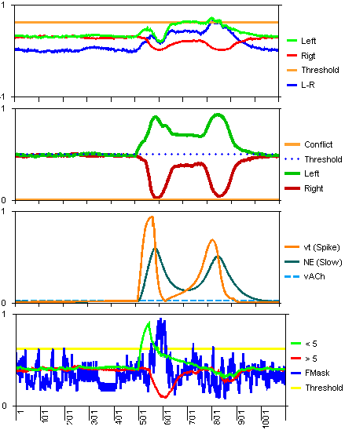
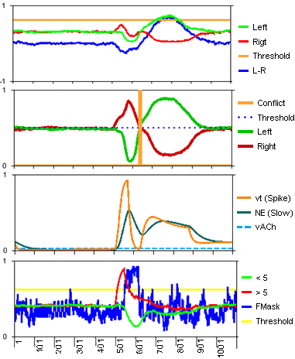


SOA 71, strength 3-3:
Congruent (698 ms) vs. Incongruent (721 ms)

Slide 47
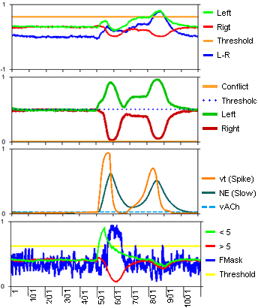
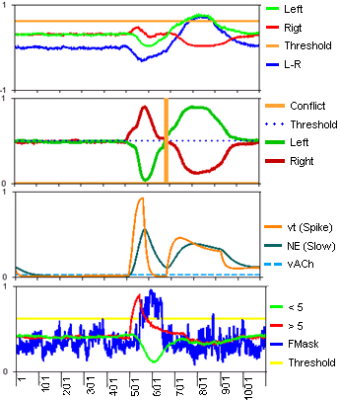
SOA 125, strength 3-3:
Congruent (779 ms) vs. Incongruent (762 ms)

Slide 48
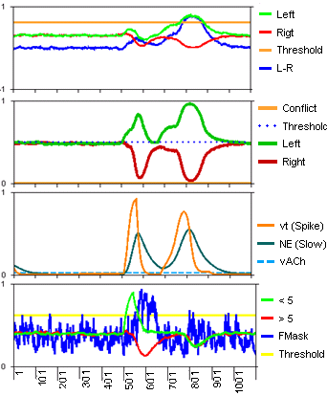
SOA 125, strength 3-3: Congruent (779 ms) vs. Congruent but irrelevant mask (772 ms)

Slide 49
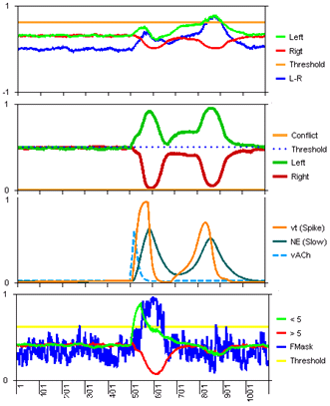

SOA 125, strength 3-3, cued prime:
Congruent (821 ms) vs. Incongruent (762 ms)

Slide 50


SOA 71, strength 2.5-2:
Congruent (744 ms) vs. Incongruent (727 ms)

Slide 51


SOA 71, strength 2.5-2, unmasked:
Congruent (735 ms) vs. Incongruent (738 ms)

Slide 52

AA response
The changes in the
refractory period as
a function of SOA (in
masked congruent
trials and prime-target
strength 3-3) for
mask-target SOAs 105,
145, 185, and 225.

Slide 53






Simulation 3: type and distance effects in Experiment 3
Modelling results for all
prime-target weight combinations.

